Slide 1



AI-Powered
Mental Wellness Assistant for Women
Devanshee Vyas (018170789)
Divya Vipulbhai Thakar (018198011)
Drashti Bhingradiya (018180578)
Keerthika Loganathan (018175807)
Khush Hemant Patel (018202548)
Yashwanth Reddy Katiplly (018227209)

Slide 2
Table of contents
01
04
02
05
03
06
Implementation
Risk & Mitigation
System Architecture
Conclusions & Recommendations
Data Analysis & Discussion
Next Steps & Demo Plan

Slide 3
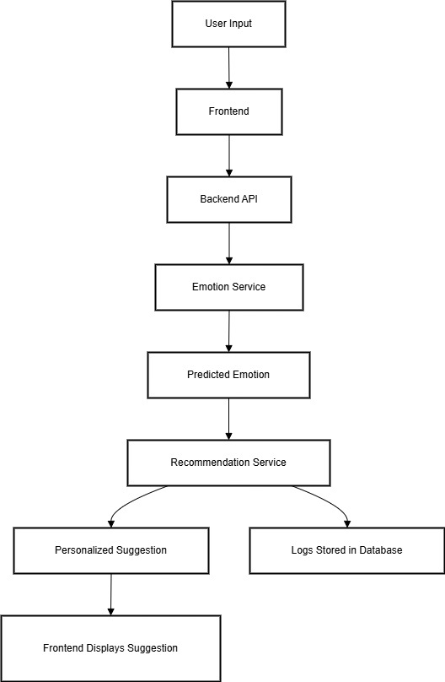
System Architecture
02

Slide 4
01
Tech Stack & Implementation
Backend:
FastAPI (Python 3.9)—REST endpoints, dependency injection
EmotionService: Hugging Face DistilBERT fine‑tuned on emotion dataset
RecommendationService: Rule‑based + embeddings fallback
AuthService & SessionService: JWT auth + Redis session store
Frontend:
ReactJS w/ Chakra UI — chat interface, dynamic rendering
Axios for API calls, React Query for caching
Containerization:
Docker + Docker Compose
Data Stores:
MongoDB Atlas—user journals & logs
Redis—session data & rate‑limit counters
CI/CD & Observability:
GitHub Actions—build, test, push to Docker Hub
Prometheus + Grafana—metrics (latency, throughput)
Sentry—error tracking

Slide 5
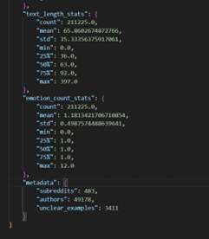
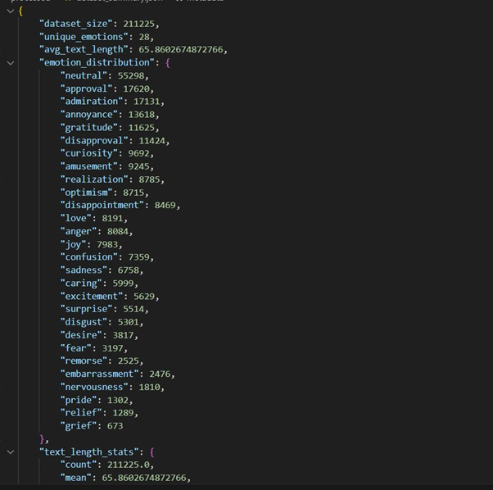
03
Data Analysis & Discussion

Slide 6

03
Data Analysis & Discussion

Slide 7
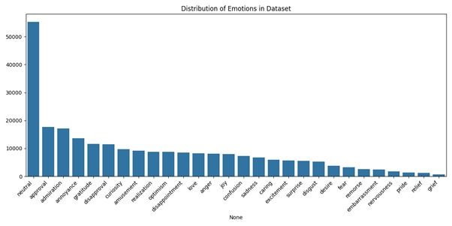
03
Data Analysis & Discussion

Slide 8
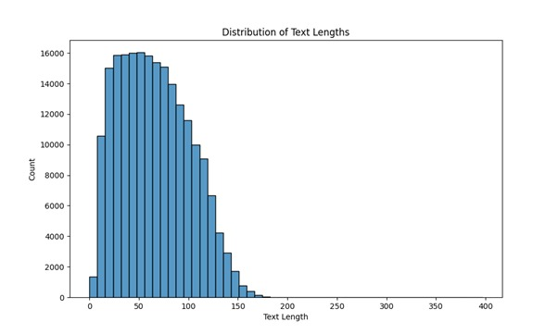
03
Data Analysis & Discussion

Slide 9
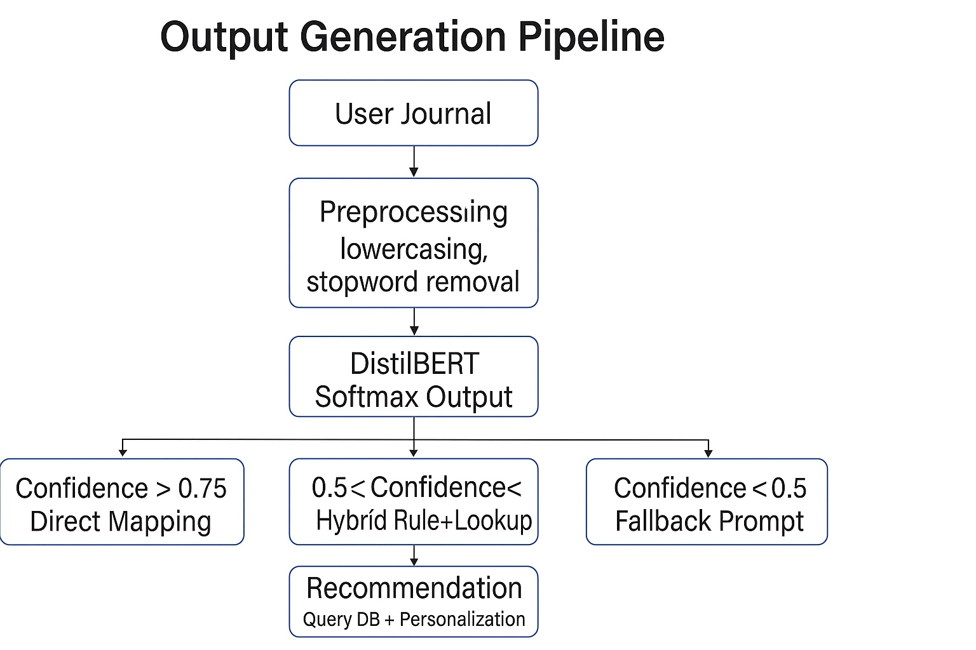
Output Generation Pipeline
1. Text Preprocessing: lowercasing, stop‑word removal
2. Embedding & Classification: DistilBERT → softmax → emotion label + confidence
3. Post‑processing:
confidence > 0.75 → direct mapping
0.5–0.75 → hybrid rule + embedding lookup
< 0.5 → fallback prompt
4. Recommendation Assembly:
Query static activity DB
Personalize via simple user‑profile rules

Slide 10
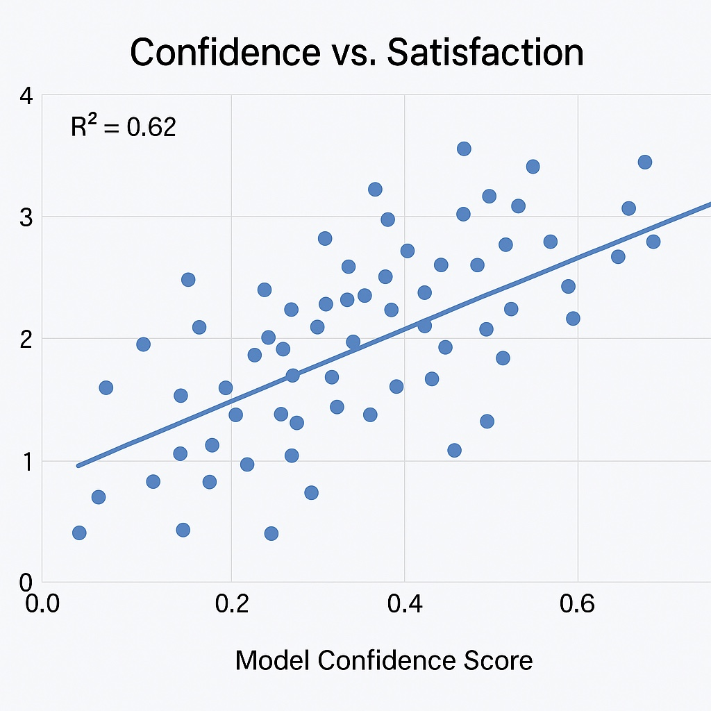
Performance & Metrics
Latency:
Avg inference: 150 ms (±20 ms)
95th percentile: 230 ms
Throughput: 200 req/s in stress test
Accuracy: 88% on validation split
F1‑Score: 0.85 across five emotion classes

Slide 11
Compare vs. Hypothesis & Abnormal Cases
Metric | Baseline Static App | Our AI Assistant
Repeat Engagement | 40% | 70%
Avg Session Duration | 2 min | 5 min
User Satisfaction (5) | 3.2 | 4.1
Abnormal Cases:
Neutral input: fallback “How can I help you today?”
Sarcasm / slang: low confidence → generic empathy response

Slide 12
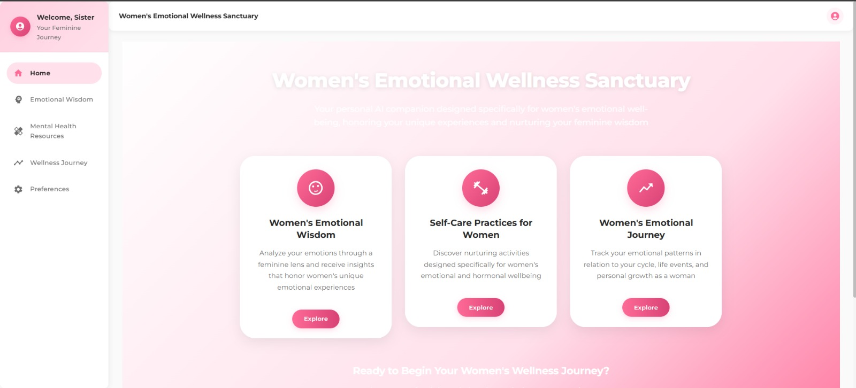
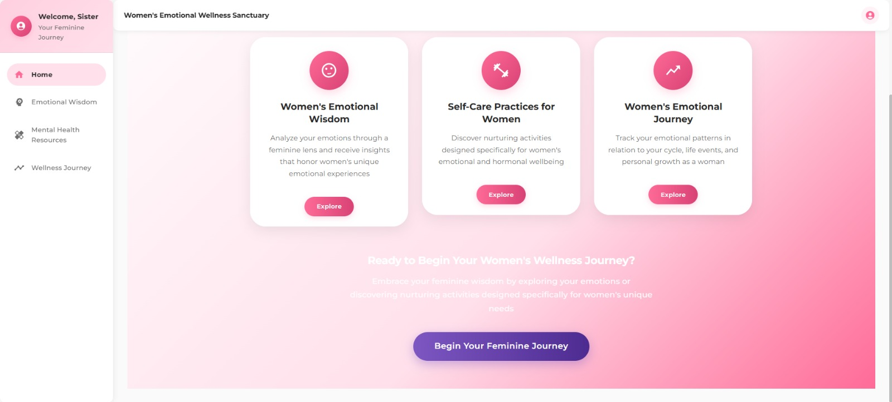
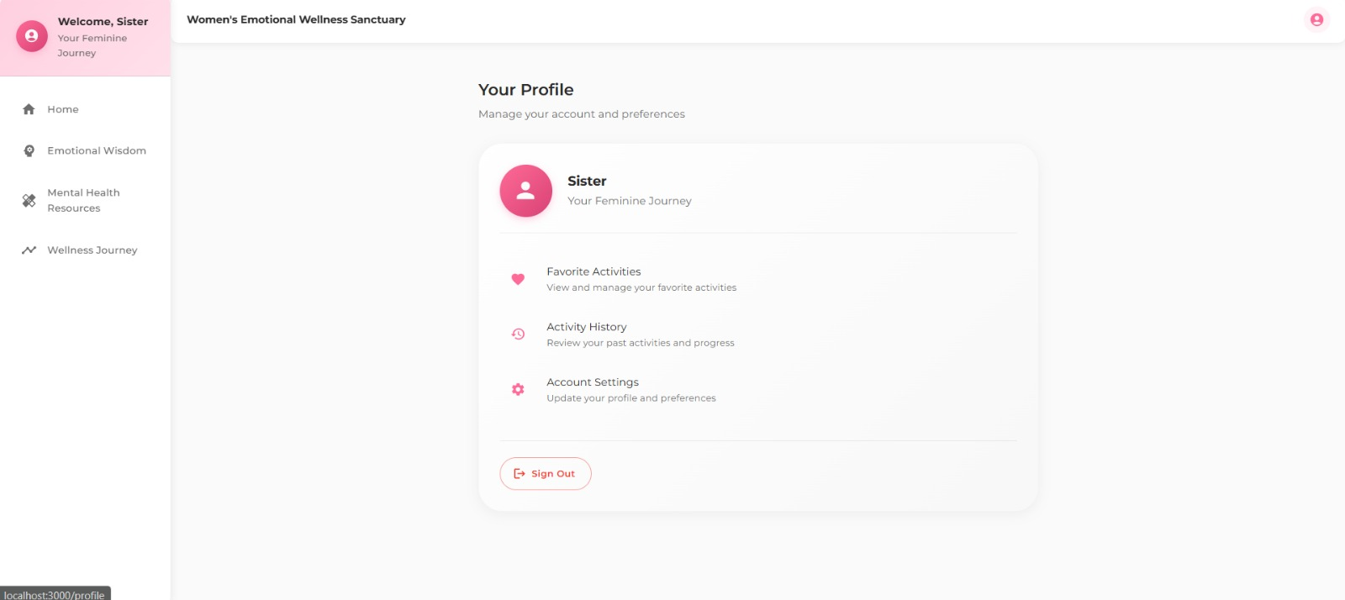
Outcome

Slide 13
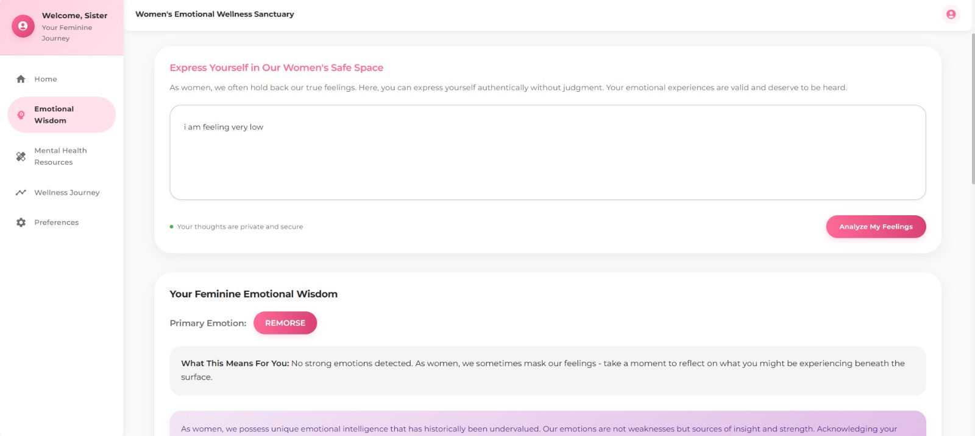
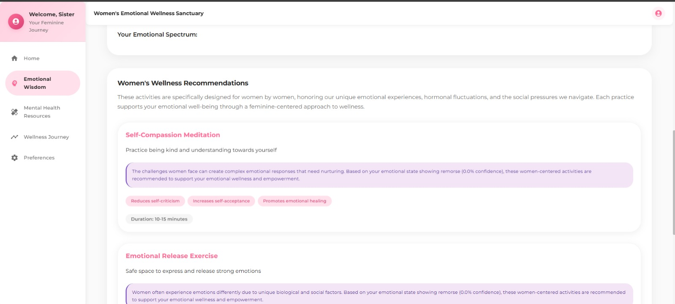
Outcome

Slide 14
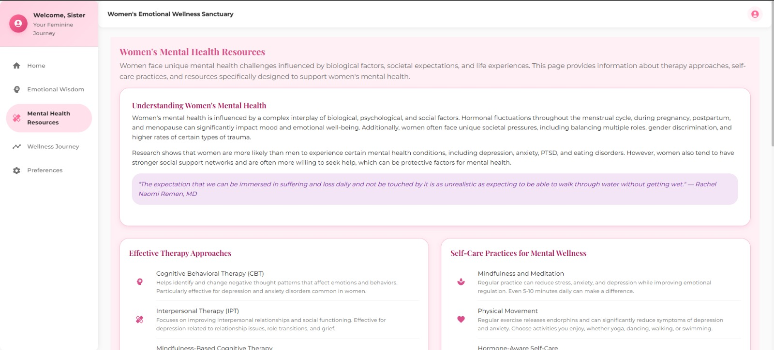
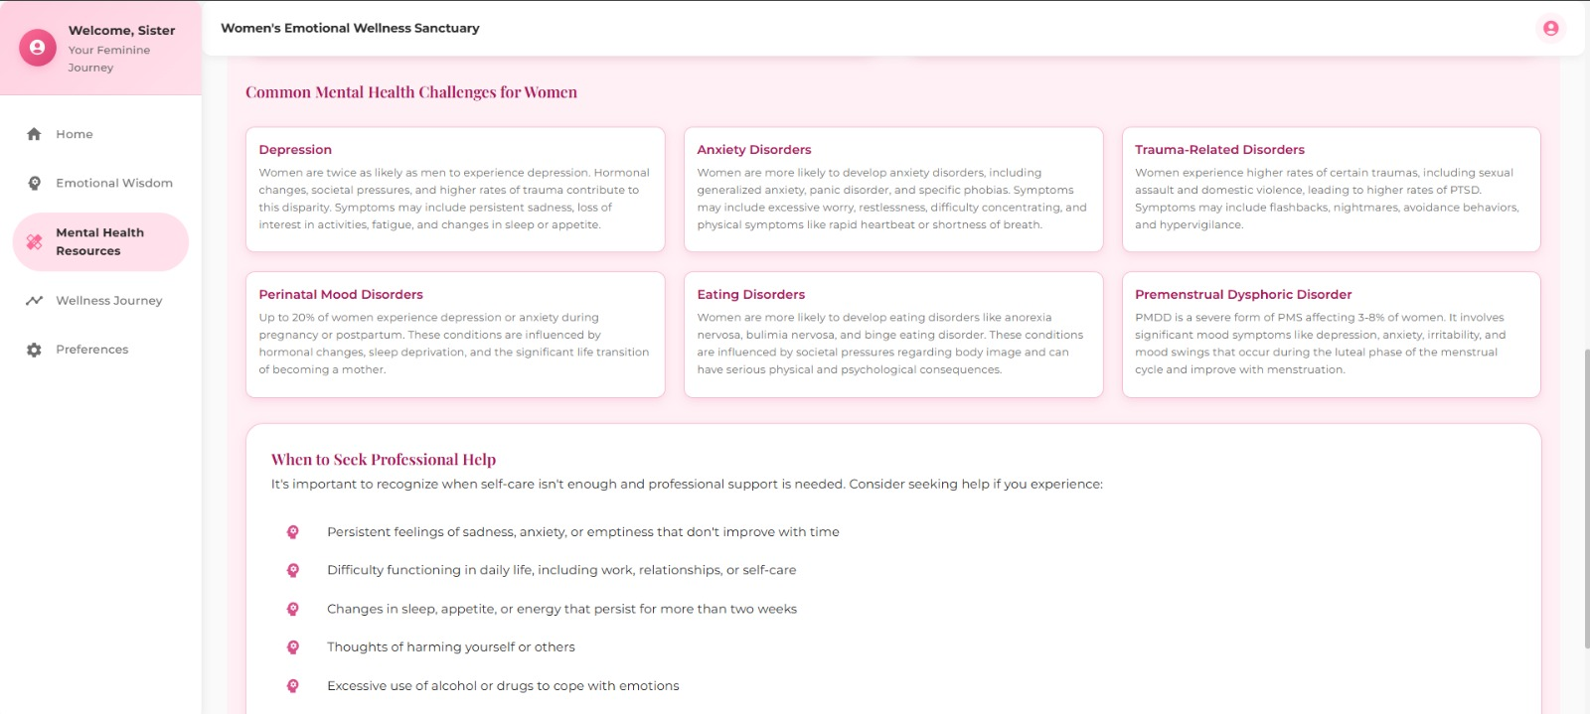
Outcome

Slide 15
Statistical Regression & Discussion
Regression Analysis:
Correlation (confidence vs. satisfaction): R² = 0.62
Linear fit: satisfaction ≈ 0.8 × confidence + 1.2
Discussion:
Strengths: modular microservices, low latency, high UX metrics
Limitations: English‑only; no voice/visual modalities; no clinical oversight

Slide 16
Risk & Mitigation
04
Data Privacy:
Risk: PII in journals → Mitigation: TLS, encrypted at rest
Model Drift:
Risk: evolving language → Mitigation: schedule monthly retraining
Scalability:
Risk: sudden traffic spikes → Mitigation: Kubernetes auto‑scaling
Bias & Safety:
Risk: inappropriate recommendations → Mitigation: manual content review + blacklist

Slide 17
Conclusions & Recommendations
05
Summary:
Achieved a scalable, responsive AI assistant with measurable UX gains
Real‑time inference under 200 ms with 88% accuracy
Recommendations:
1. Voice/Multimodal Interface (TensorFlow Lite + edge inference)
2. Multilingual Support (mBERT fine‑tuning)
3. Reinforcement Learning for personalized pathways
4. Clinical Validation with mental‑health experts

Slide 18
06
Next Steps & Roadmap
Voice emotion detection PoC
Deploy on Kubernetes + Helm charts
Multilingual support (Spanish, Mandarin)
Clinical pilot study

Slide 19
Demo

